Slide 1
MOBILE APPLICATION DEVELOPMENT
Project Definition:
Forever Family Saloon App ​

Slide 2
TEAM
Sapna Dangar - 20SOECE11010
Mansi Chanu – 20SOEIT11005
Urmila Chakrabarty – 20SOECE11117

Slide 3
INTRODUCTION
We are creating an app for the Forever Family Salon that offers features like booking appointment, leaving reviews, displaying the catalogue, opening and closing times, etc.

Slide 4
WIRE FRAMES

Slide 5
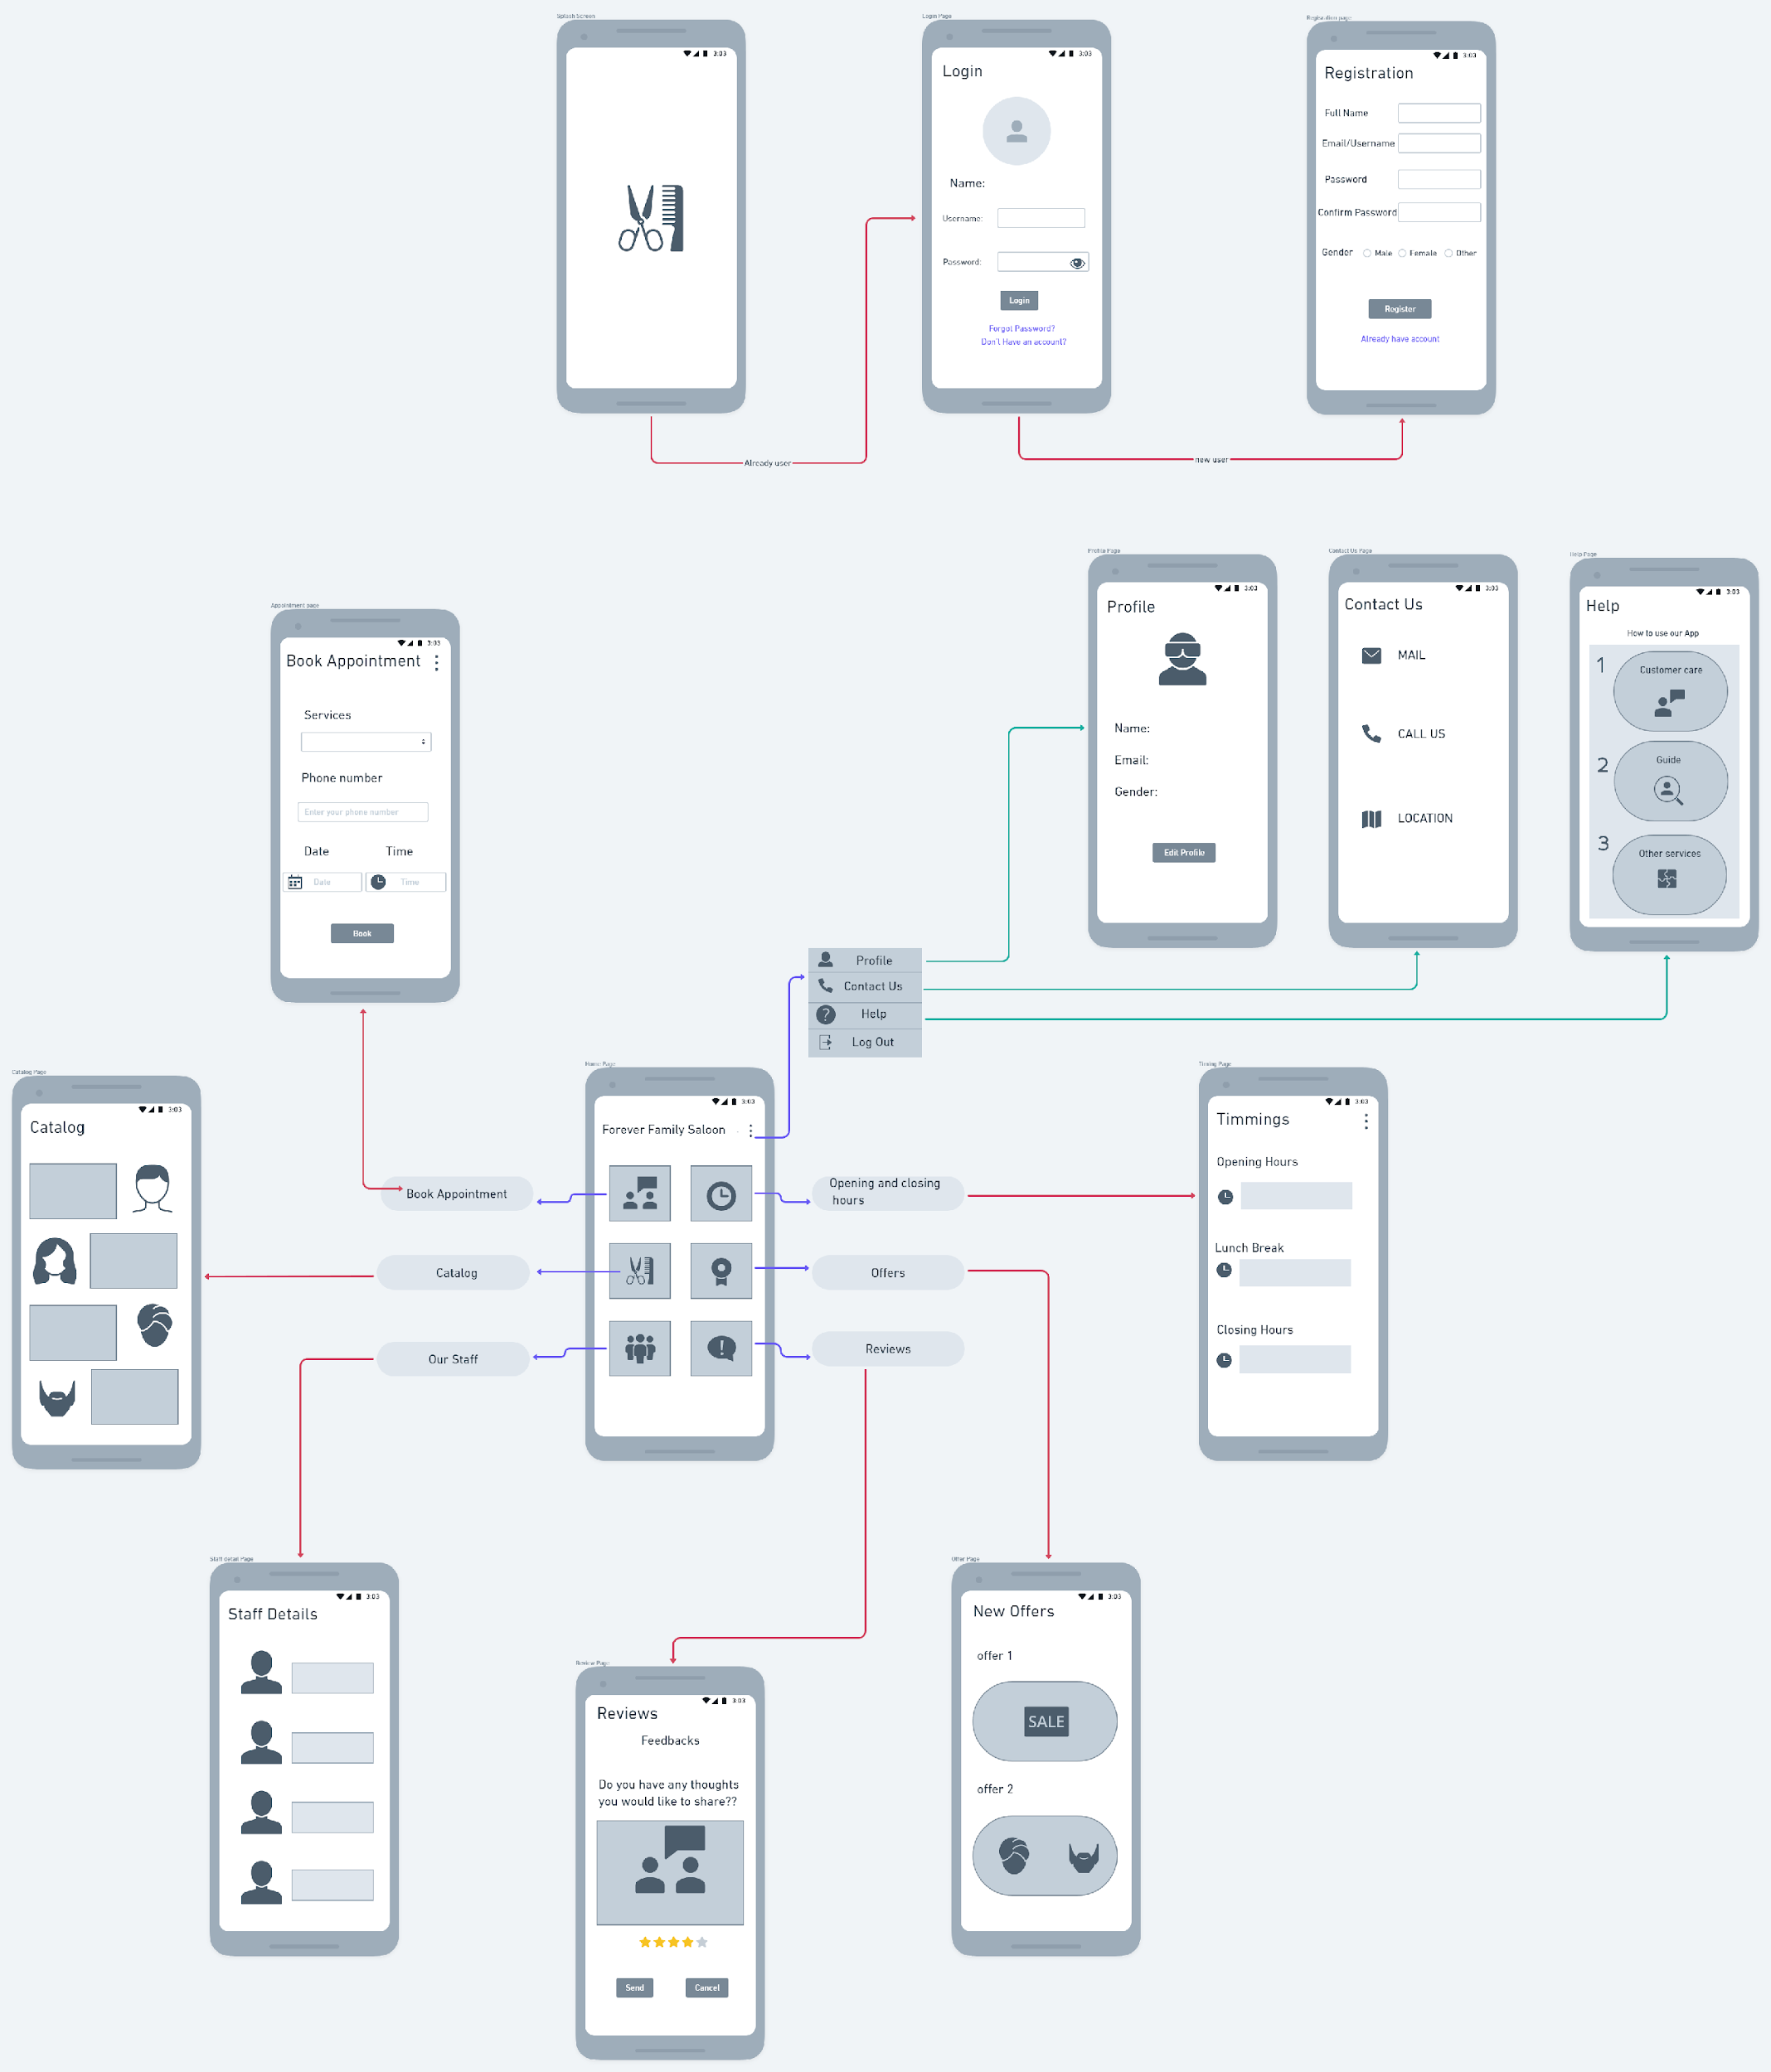

Slide 6
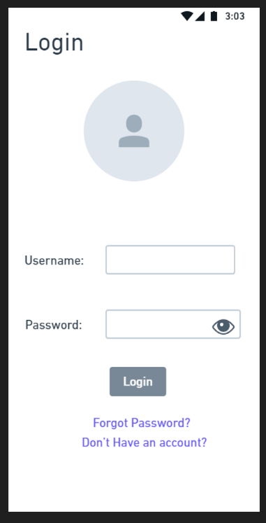
LOGIN
Image View
In this image view you can upload picture for profile
Text View
This text view show the label
Edit text
This two edit text is used to take user input
Text View
This text view will act as link that will direct to another activity
Button
By clicking the Login Button it will verify the user credentials

Slide 7
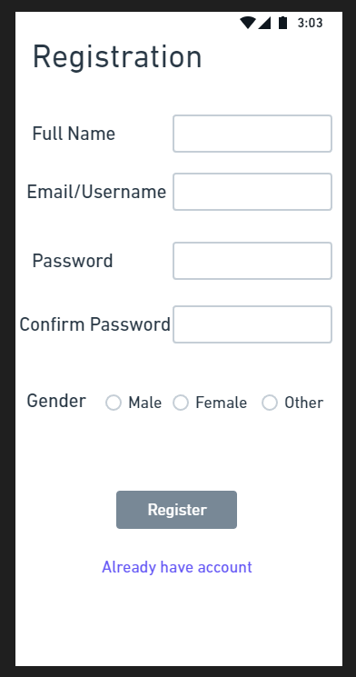
REGISTRATION
Edit text
This two edit text is used to take user input
Text View
This text view show the label
Radio Group and Radio Buttons
User can select any one radio button
Button
By clicking the Register Button it will store user data into database
Text View
This text view will act as link that will direct to login activity

Slide 8
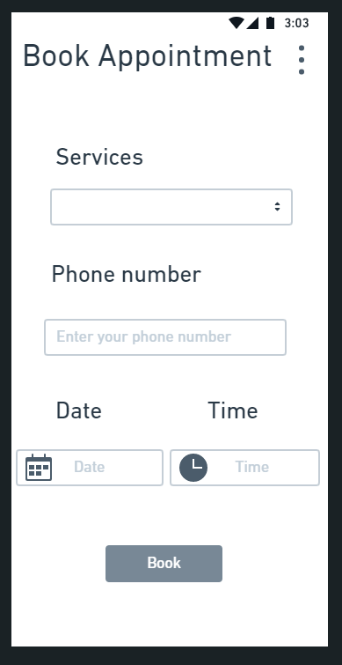
APPOINTMENT
Text View
This text view show the label
Spinner
It will show dropdown menu with available options
Text View
This text view show the label
Edit text
This edit text is used to take phone number as user input
Text View
This text view show the label
Text View
This text view show the label
Button
On clicking this button it will send the data

Slide 9
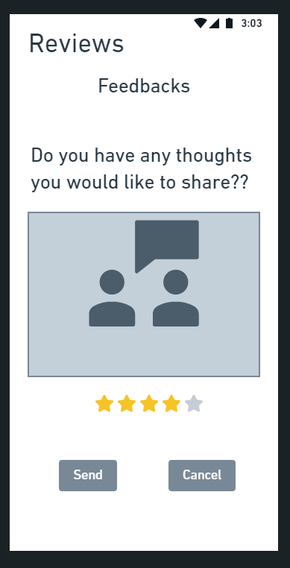
REVIEW
Text View
This text view show the label
Text View
This text view show the label
Edit text
This edit text is used to take user review
Button
On clicking this button it will send the data
Button
On clicking this button it will clear the feedback

Slide 10
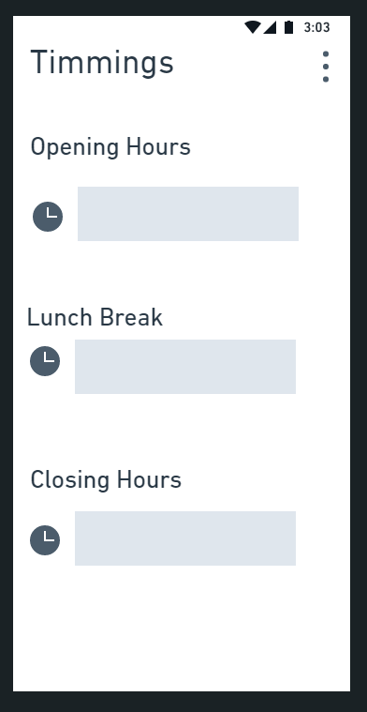
TIMING
Text View
This text view show the label
Edit text
This edit text will show opening time
Text View
This text view show the label
Edit text
This edit text will show lunch break time
Text View
This text view show the label
Edit text
This edit text will show closing time

Slide 11
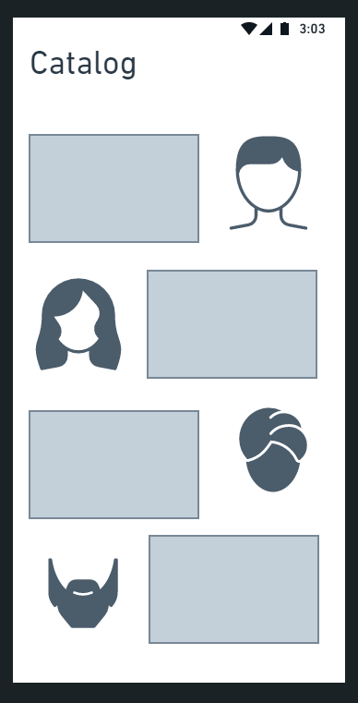
CATALOG
Text View
This text view show the label
Image View
This will show an image of different styles
Image View
This will show an image of different styles
Text View
This text view show the label
Image View
This will show an image of different styles
Text View
This text view show the label
Image View
This will show an image of different styles
Text View
This text view show the label

Slide 12
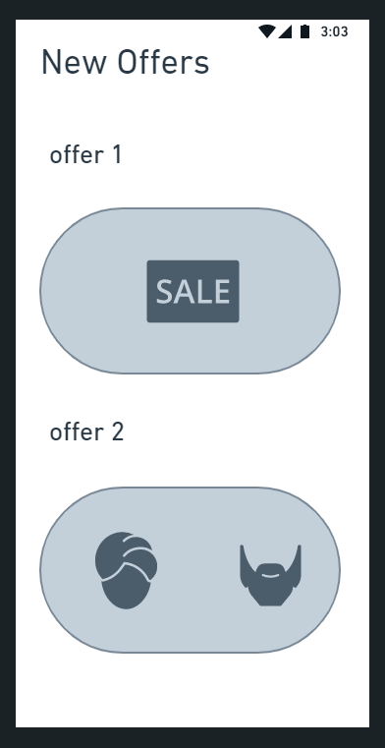
OFFERS
Text View
This text view show the label
Text View
This text view show the label
Text View
This text view show the label
Text View
This text view show the label

Slide 13
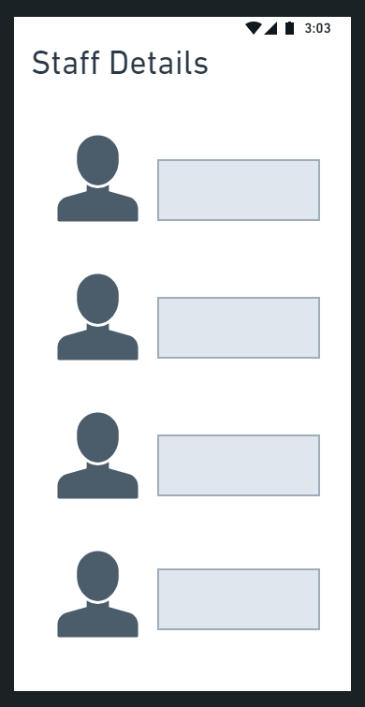
STAFF DETAILS
Image View
This will show an image of the staff members
Text View
This text view show the label
Image View
This will show an image of the staff members
Text View
This text view show the label
Image View
This will show an image of the staff members
Text View
This text view show the label
Image View
This will show an image of the staff members
Text View
This text view show the label

Slide 14
Link to our complete wireframe
Forever Family Saloon (whimsical.com)

Slide 15
Analysis Models

Slide 16
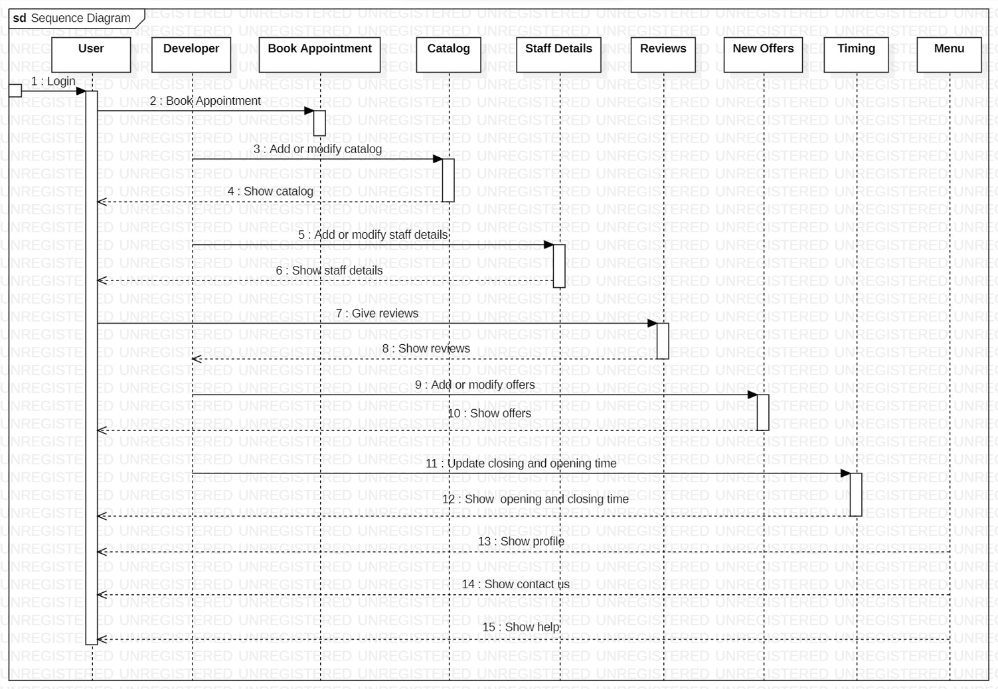
Sequence Diagram

Slide 17
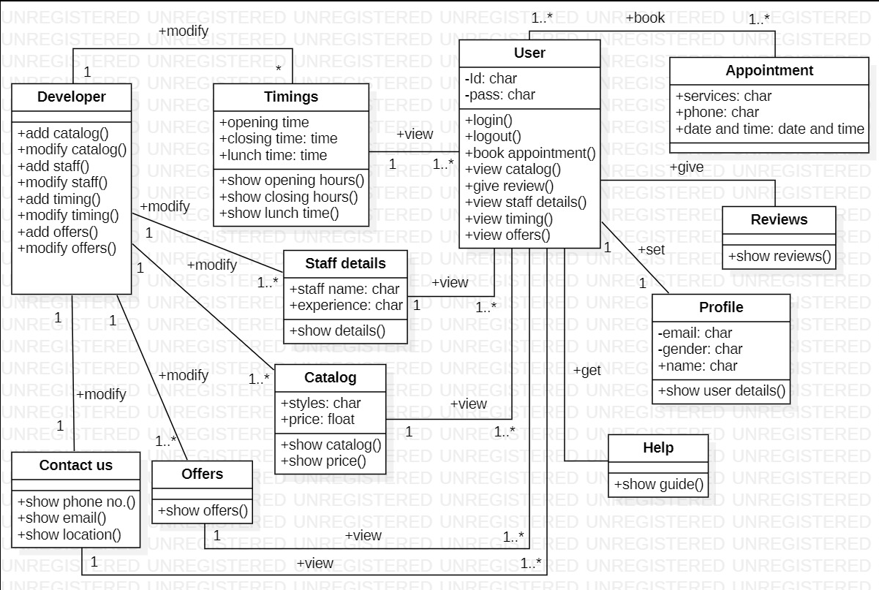
Class Diagram

Slide 18
Future Enhancement
Online Payment
Data encryption
Membership Card
Separate Admin and User Panel

Slide 19
Limitations
Very less use of dynamic data
No Proper Optimisation for storage
Software maintenance complexity
Basic and Simple UI

Slide 20
Github Link
https://github.com/urmila-chakrabarty/ANDROID_TSEE

Slide 21
THANK YOU

